Slide 1


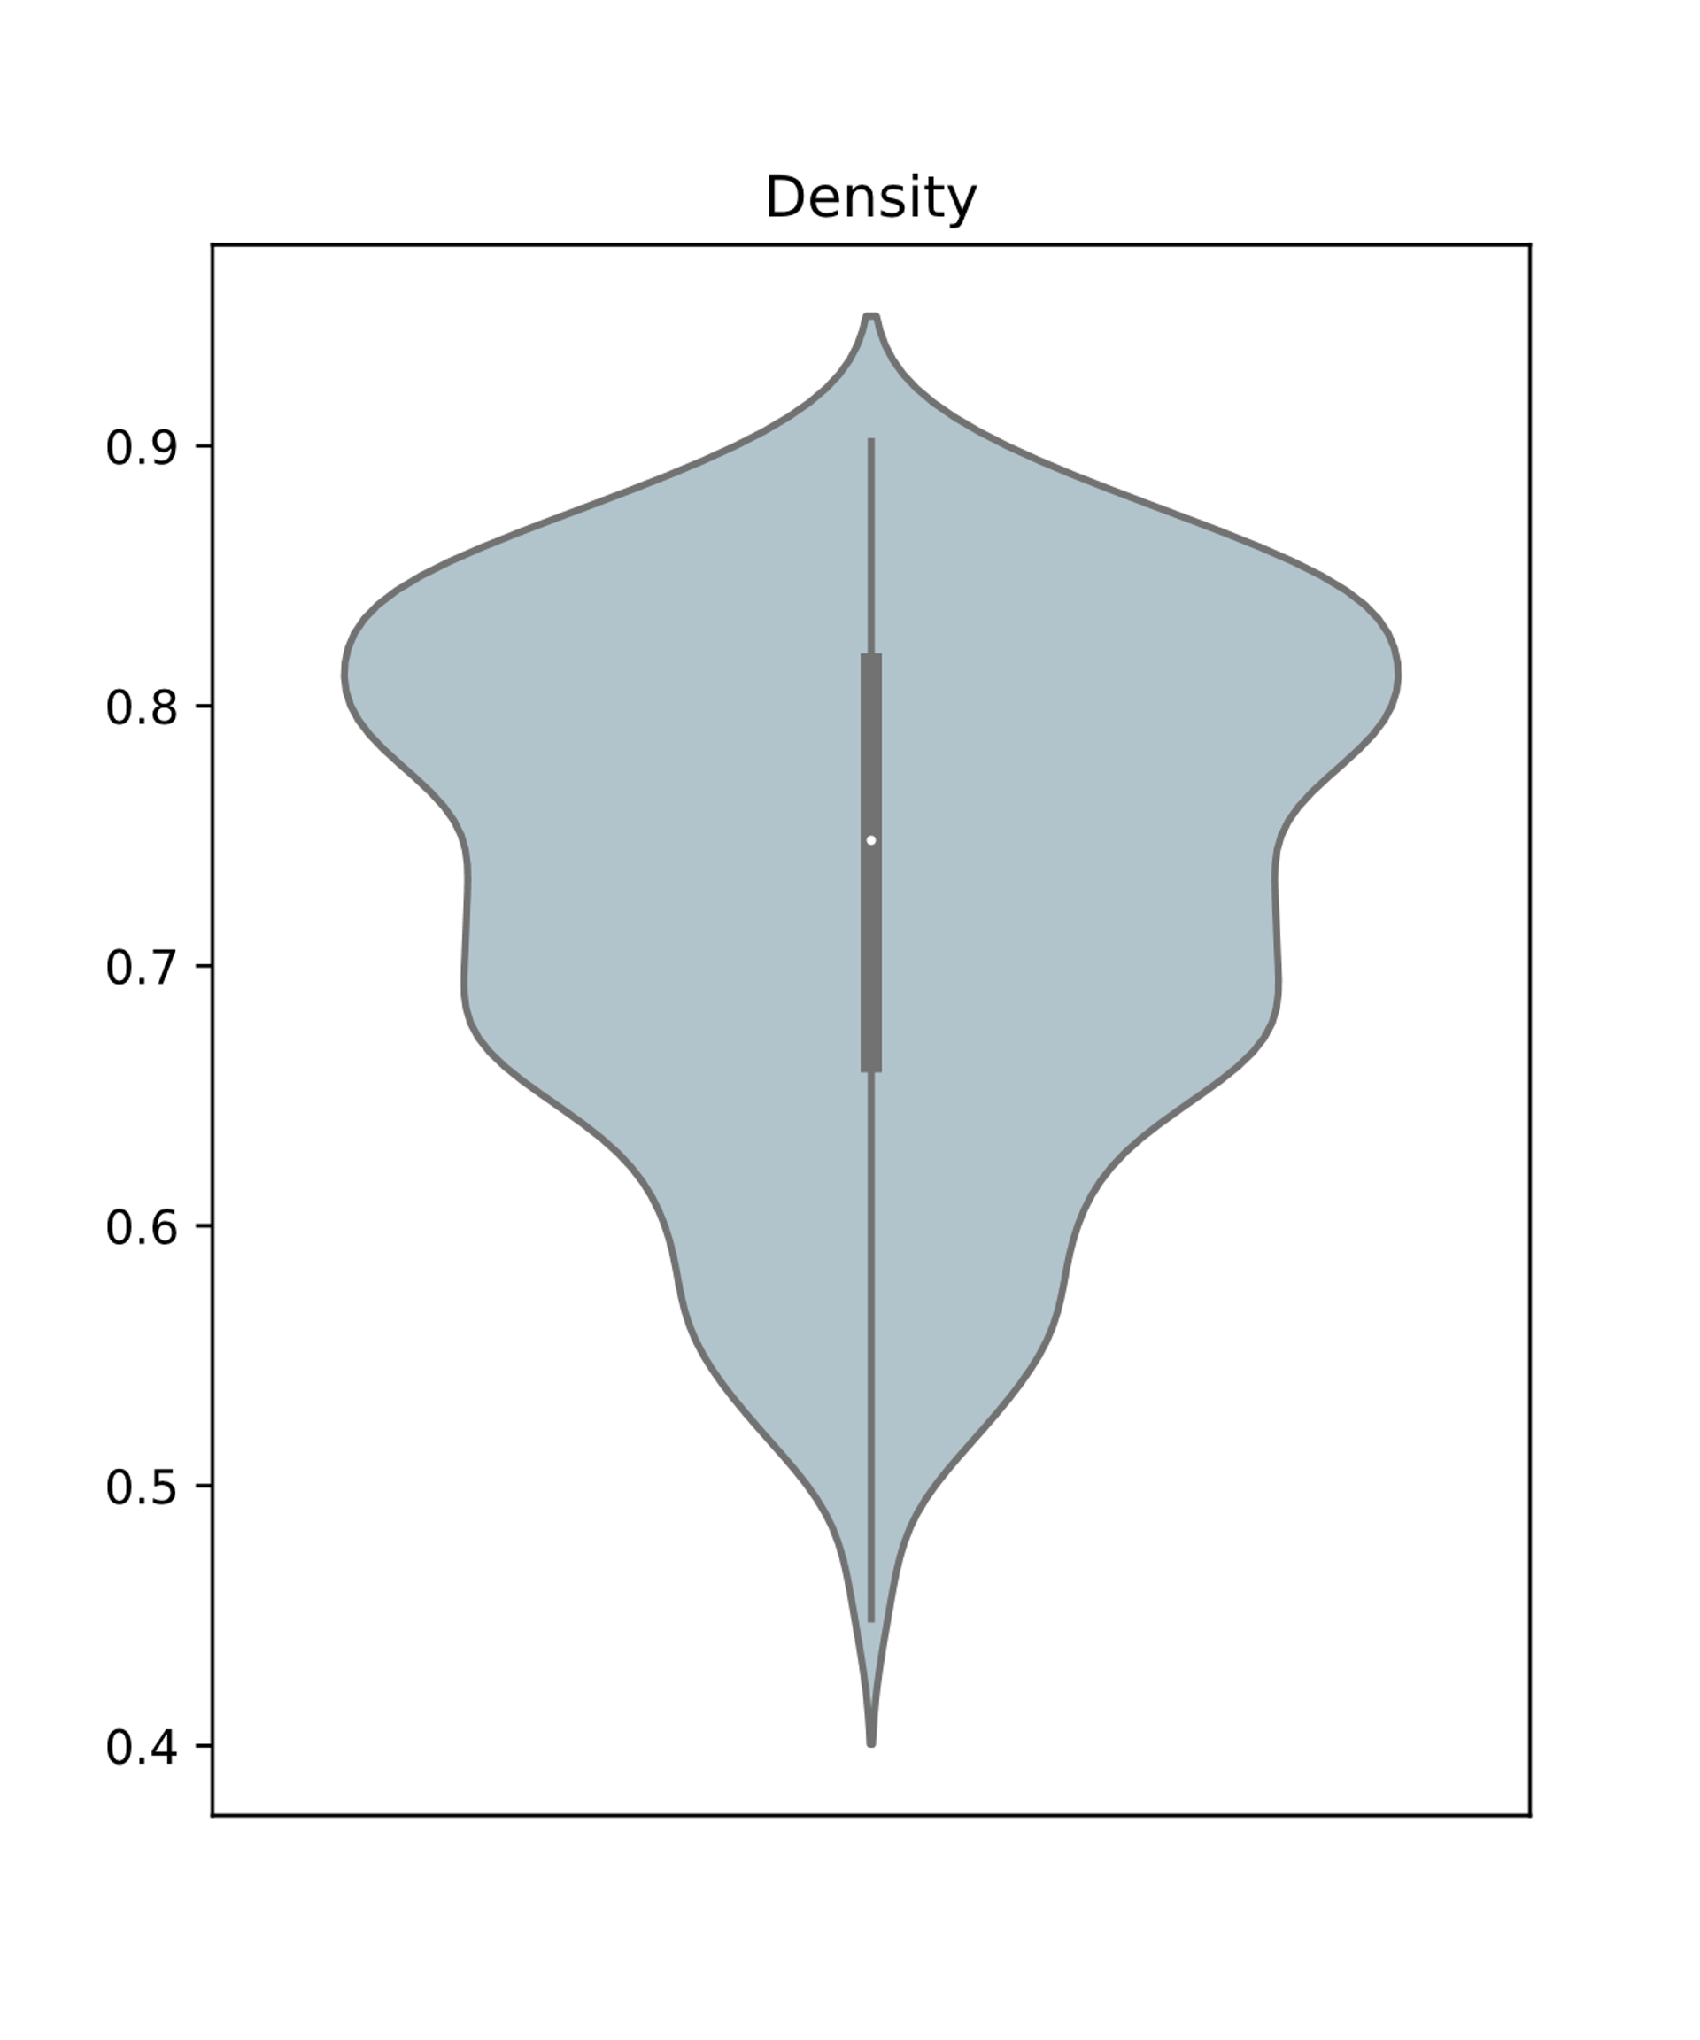
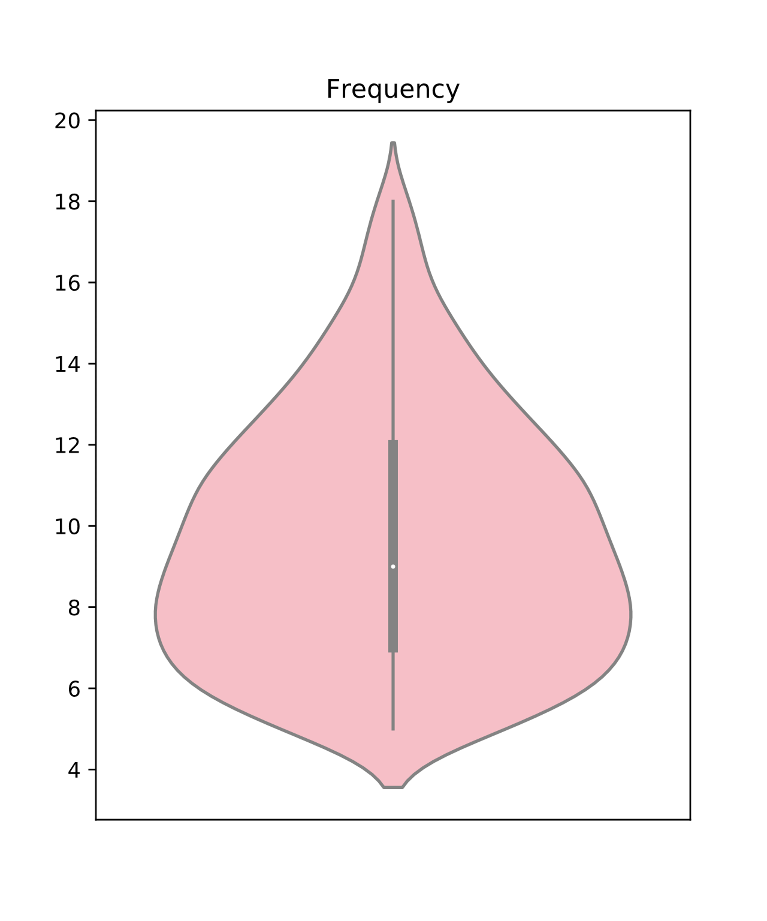
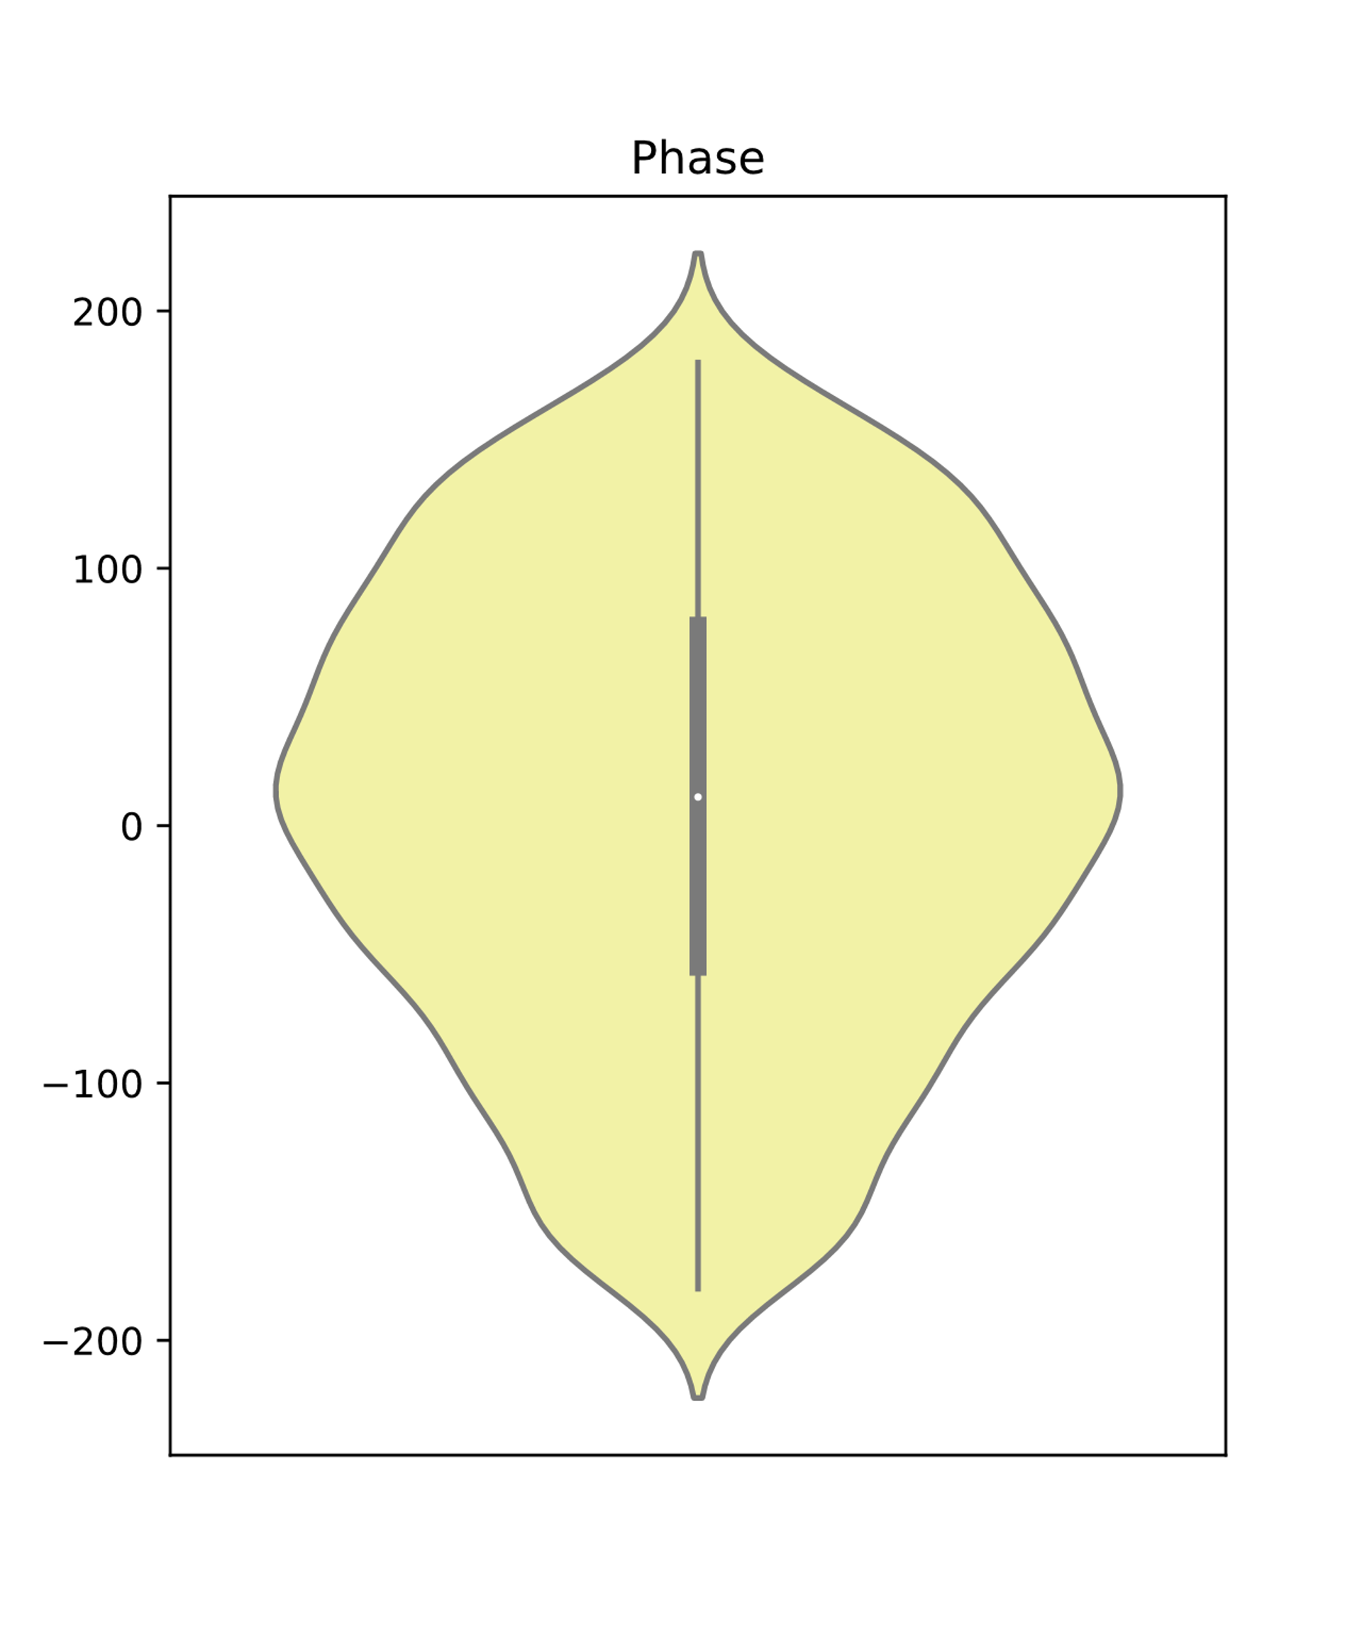
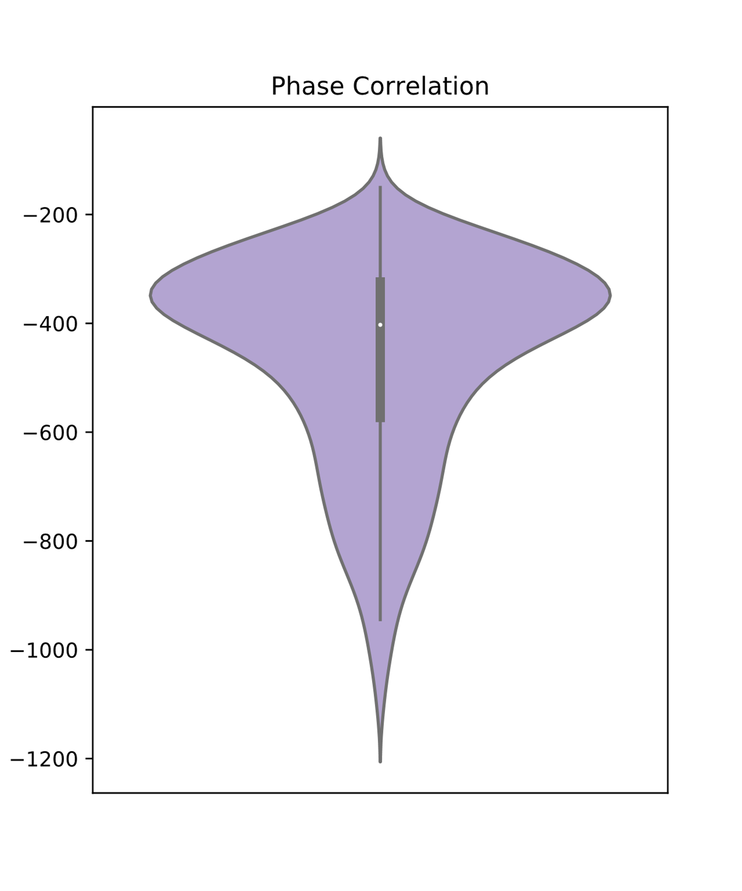
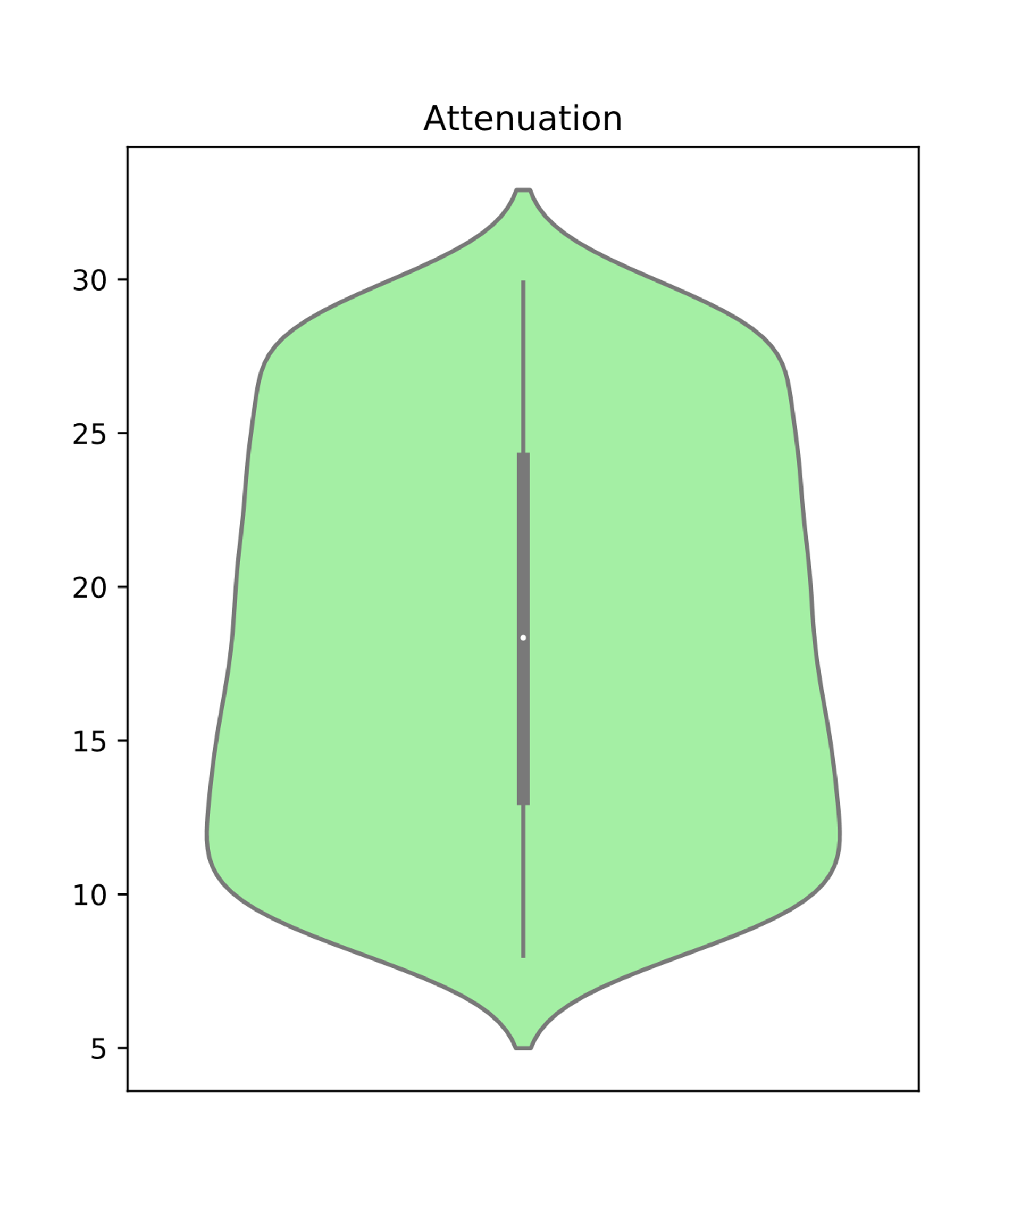
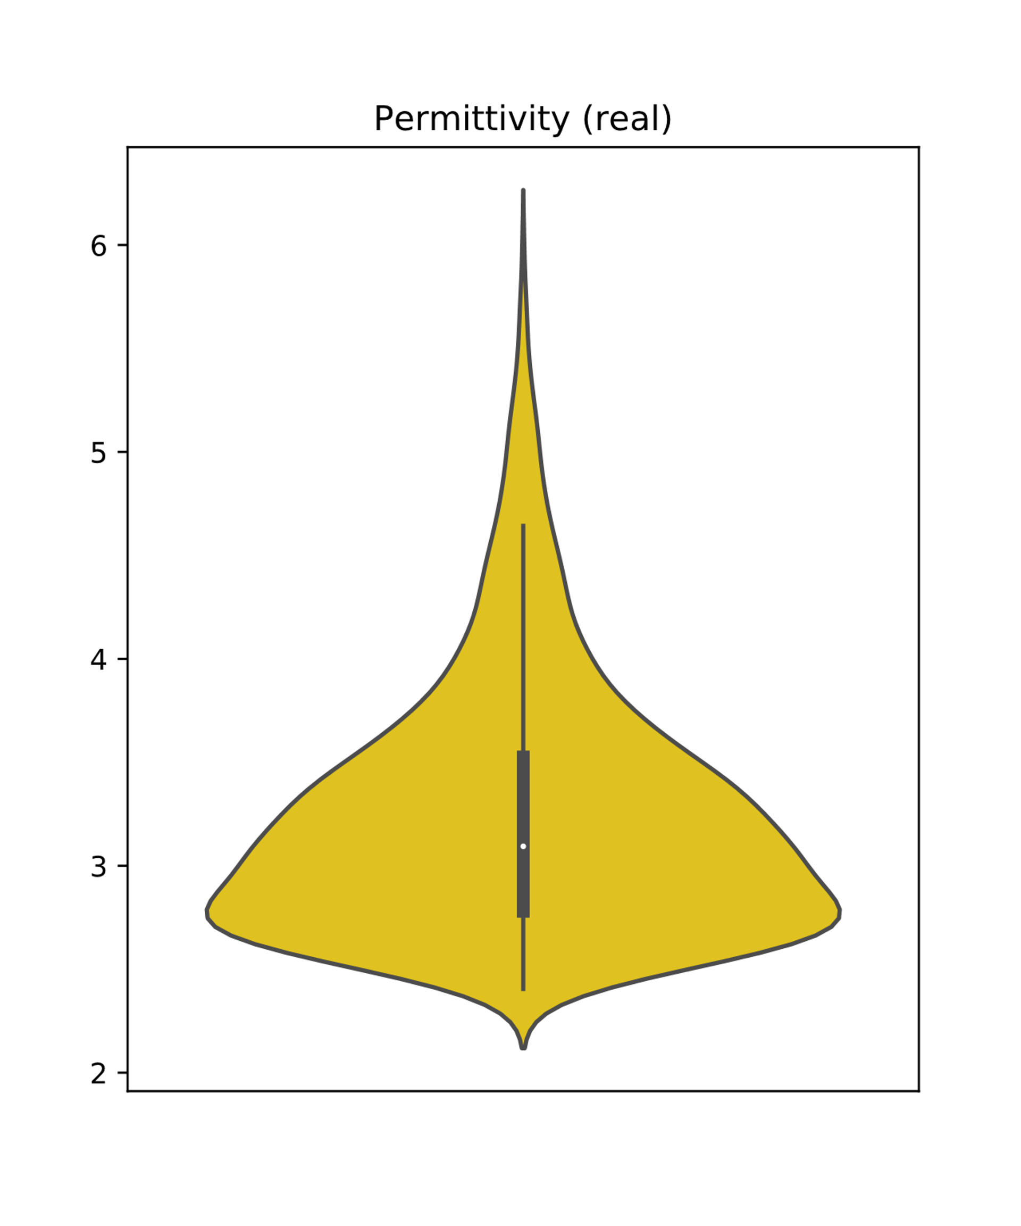
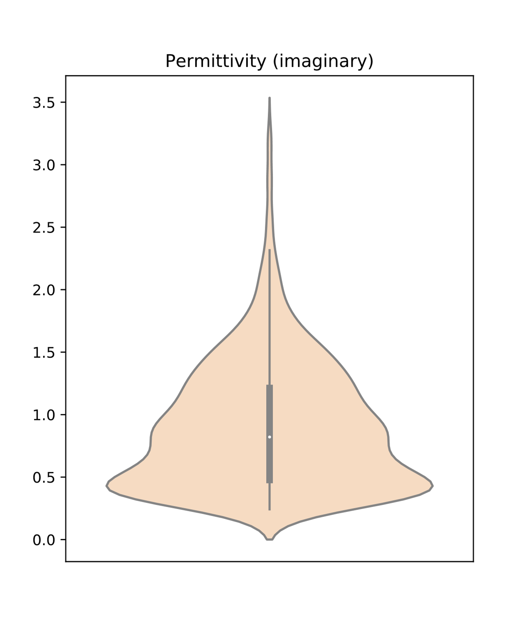
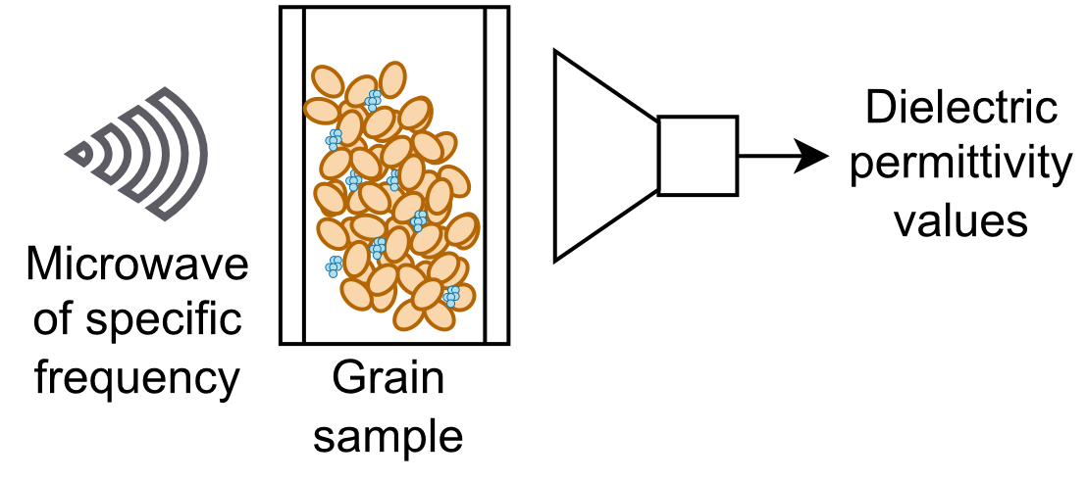
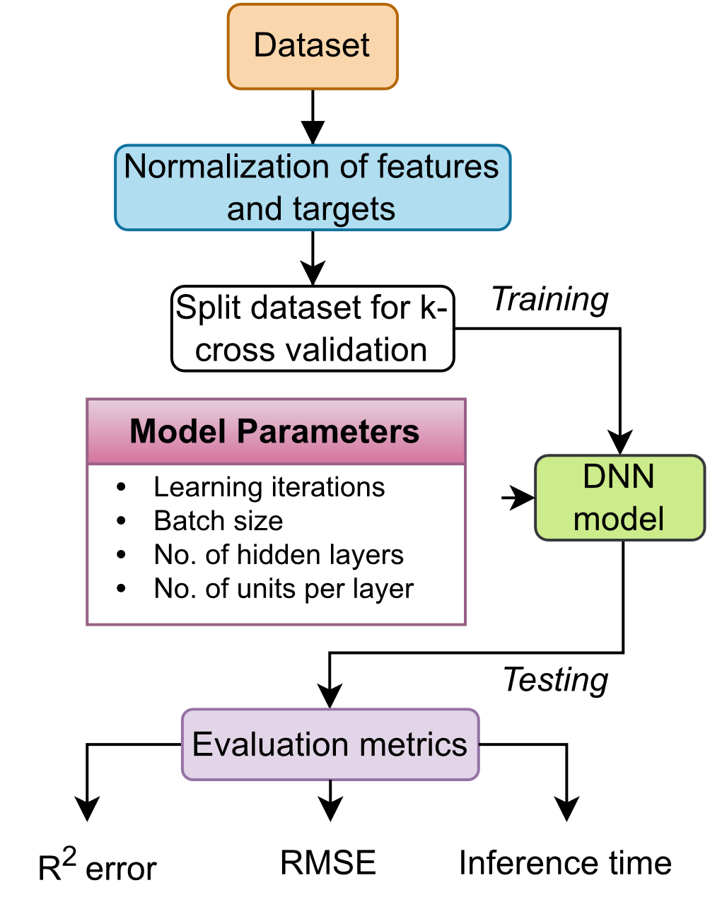
Predicting moisture content of various grains from its dielectric properties
Zeenat Islam*, Dr. Hussein Gharakhani† , Dr. Samir Trabelsi‡
*Computer Science and Engineering, †Agricultural and Biological Engineering, ‡US National Poultry Research Center
Background and Motivation
Visualizing the dataset
Water's polar nature leads to strong coupling between microwave frequencies and dielectric properties of moisture-containing materials.
This can assist in predicting real-time moisture-content in grains by using measurements of these properties.
Official MSU Colors
Objectives
Provided a dataset of different microwave frequencies and corresponding dielectric properties measurements, we predict the moisture content of several grains:
Wheat | Sorghum
Barley | Soybeans
Oats | Corn
Results
Methodology
0.5” Square that can be used for measuring margins and spacing
Conclusions
Acknowledgements
We would like to acknowledge the funding agency USDA Agriculture Research Service (USDA-ARS) for supporting this research.

